Slide 1
Enhancing Workplace Mental Health Evaluating Mental Health Support Programs (MHSPs)
Group 4
Authors: Boping Song, Jiayao Wei, Tianji Li, Yuntong Zhang

Slide 2


Problem Statement
Our study examines the impact of mental health support programs on productivity, turnover, and job satisfaction in industries like technology, retail, and finance. By collaborating with organizations committed to employee well-being, it aims to provide empirical evidence on how these programs affect performance metrics, which can help companies to optimize mental health resources that reduce the effects of workplace stress.

Slide 3



Literature Review
Stress, depression, and anxiety reduce cognitive function and productivity
(Wang et al., 2020)
Organizations with effective Employee Assistance Programs report lower voluntary turnover rates
(Attridge, 2009)
MHSPs improve engagement and resilience
(Demerouti et al., 2001).
Psychological distress and well-being can be reduced and increased respectively by providing mental health interventions in the workplace (Joyce et al., 2016)
Supportive workplaces increase loyalty and satisfaction
(Blau, 1964)
Workplaces with a mental health-orientated culture not only have lower turnover rates but also have a greater work satisfaction
（Milligan-Saville et al., 2017)

Slide 4


Research Questions & Hypotheses
1. Research Questions:
How do MHSPs impact employee performance, satisfaction, and retention?
Which MHSP components (e.g., counseling) are most effective in reducing burnout?
Do MHSP impacts vary by demographics (age, role, tenure)?
2. Hypotheses:
H0 (Null): MHSPs have no significant impact on outcomes; components are equally effective; no demographic differences.
H1 (Alternative): MHSPs improve outcomes; certain components are more effective; demographics moderate effectiveness.
3. Key Insights:
MHSPs likely enhance performance and retention.
Tailored strategies may maximize impact.
Research outcomes can guide HR in creating effective mental health policies.

Slide 5

Research Plan
Sampling: Stratified random sampling (balanced by gender and age).
Intervention:
Mindfulness and Stress-Management Training

Slide 6
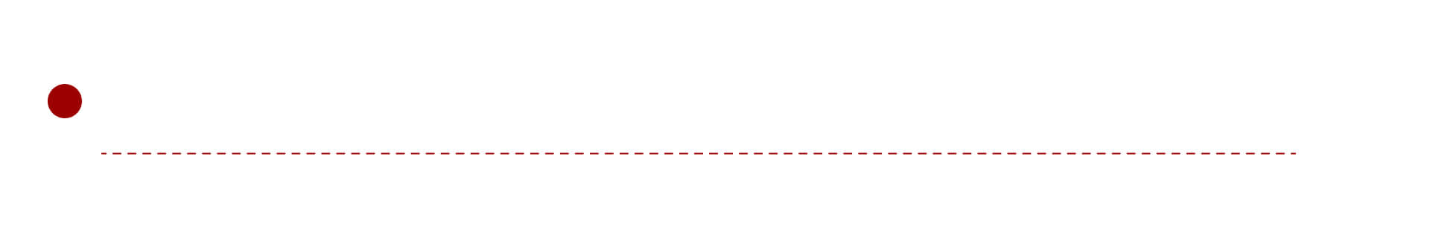
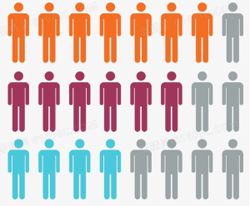
Population of Interest
Employees of large and medium-sized enterprises
Since enterprises above a certain scale have the ability to regularly implement employee mental health support plan. Therefore, this research mainly examines employees of large and medium-sized enterprises with more than 50 employees

Slide 7
Sample Selection & Sample Size
Stratified random sampling
Stratified random sampling method was used
Age ：40% of employees under the age of 30, 40% of employees aged 30-40, and 20% of employees over the age of 40.
Sex： Gender equality.
The sample size in the designed plan is estimated at 300-500 people. The final sample should compose of 60-100 male and 60-100 female employees under the age of 30; 60-100 male and 60-100 female employees aged 30-40; And 30-50 male and 50 female employees over the age of 40.

Slide 8

Operational Procedures
Recruitment and Participation:
Employees recruited internally
Has to be individuals experiencing mild to moderate stress
Those with severe challenges are excluded
Participation is voluntary and incentivized with gift cards
Program Structure:
6-month mindfulness and stress management program
Weekly 60-minute sessions to practice techniques for stress management
digital resources provided as additional support

Slide 9

Data Collection
Data Points:
Subjective (Job Satisfaction Index Objective), Objective (KPIs), Retention (Employee turnover rates)
Timeline:
Baseline, midpoint (3 months),
and end of the program ( 6 months)
Confidentiality:
All data anonymized, Restricted access, Managed within organization secure system

Slide 10

Study Variables
Outcomes (Dependent Variables):
Control Variables:
Job Performance: Tracked via KPIs (e.g., completion rates, quality).
Employee Satisfaction: Surveyed monthly (1–5 scale).
Turnover Rate: Ratio of voluntary separations.
Age, gender, job role, tenure, industry.
Treatment (Independent Variable):
Mental Health Support Program (MHSP):
Counseling: Biweekly sessions.
Workshops: Weekly stress management.
Digital Tools: Resources, webinars, 24/7 hotline.

Slide 11

Statistical Analysis Plan
Research Question 1
Research Question 2
Research Question 3
In this research, 2-sample t test will be used on job performance data and job satisfaction data, and 2-sample test for proportions will be used on retention data. p-values will be used to evaluate the statistical significance of the variables and the performance of the tests.
For component effectiveness analysis, 2-sample t test will be used to evaluate the distinct effects of each program component on continuous outcomes similar to research question 1, as well as p-value will be used for identifying the statistical significance of simulated data.
For component comparison analysis, analysis of variance (ANOVA) will be applied to compare mean of factors across groups utilizing different components, thereby identifying whether differences between components are statistically significant. Meanwhile, F-value and p-value will be calculated to evaluate the capacity of the tests.

Slide 12


Possible Recommendations
Research Question 1
Research Question 2
Research Question 3
Not reject H0:
Improve MHSP used before.
Integrate alternative interventions.
Identify barriers to improve effectiveness.
Reject H0:
Continue scaling the MHSP.
Further investments in promotional efforts.
Recommend success to more workplaces.
Not reject H0:
Focus on optimizing the delivery of all program.
Components collectively
simplify the program structure.
Reject H0:
Prioritize and expand the most effective component.
Tail the program for specific employee groups.
Not reject H0:
Apply uniformly across all demographics and roles.
Detect potential disparities over time.
Reject H0:
Customize program elements.
Target high-impact subgroups with enhanced resources.
Ensuring no group is left behind.

Slide 13


Limitations and Uncertainties
Outcomes are influenced by various external factors such as organizational culture, leadership styles, economic conditions, and etc.
The statistical power to detect differences in similar subgroups may be limited when researching for the third research question, particularly if the sample size is unevenly distributed across categories.
Self-reported surveys are prone to bias like social desirability bias, and respondents may overstate the program’s benefits to align with organizational expectations.
The research may not fully address the long-term sustainability of MHSP benefits as it captures short term effects more and work dynamics evolve over time.

Slide 14
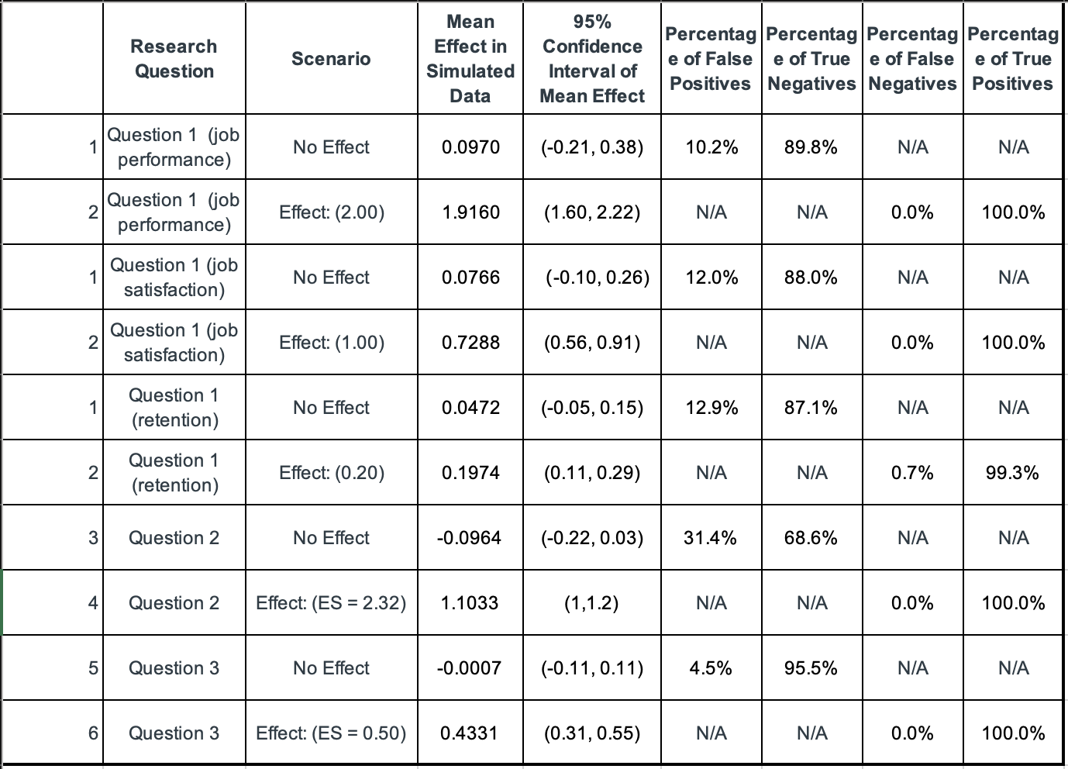
Simulation Result

Slide 15
Key findings
Research Question 1（How do MHSPs impact employee performance, satisfaction, and retention?）
For Expected Effect Scenario, the confidence intervals for three variables do not overlap zero and confirm the positive effects , but retention gains a smaller effect. For No Effect Scenario, the vast minority (0.107) of simulated job performance data has the p-value that is smaller than 0.05, and that of job satisfaction and retention rate are in the same case (0.12 and 0.141), which implies that the treatment had no impact on the outcomes.
Research Question 2（Which MHSP components (e.g., counseling) are most effective in reducing burnout?）
For Expected Effect Scenario, personalized counseling showed strong positive impact (Effect size: 1.103, p < 0.05). For No Effect Scenario, no significant difference observed (Effect size: -0.096, CI crossed zero).
Research Question 3（Do MHSP impacts vary by demographics (age, role, tenure)?）
For the Expected Effect Scenario, the significant positive effect (Mean Effect: 0.4331, CI: 0.3128-0.5534) suggests targeted customization, while the No Effect Scenario reveals no significant impact, indicating the need for a uniform program with ongoing monitoring for potential disparities.

Slide 16
References
Wang, J., et al. (2020). Mental health and work performance: How mental health support improves job efficiency. Journal of Occupational Health Psychology.
Joyce, S., et al. (2016). Workplace interventions for common mental disorders: A systematic meta-review. Psychological Medicine, 46(4), 683-697.
Demerouti, E., Bakker, A. B., Nachreiner, F., & Schaufeli, W. B. (2001). The job demands-resources model of burnout. Journal of Applied Psychology, 86(3), 499-512.
Halbesleben, J. R. B., & Buckley, M. R. (2004). Burnout in organizational life. Journal of Management, 30(6), 859-879.
Attridge, M. (2009). Employee assistance programs: A research-based primer. EAP Digest, 29(3), 22-27.
Danon, M., & Kramer, H. (2018). Mental health support and its role in enhancing employee satisfaction and loyalty. Journal of Workplace Behavioral Health, 33(2), 101-115.
Blau, P. M. (1964). Exchange and Power in Social Life. New York: John Wiley & Sons.
Milligan-Saville, J. S., et al. (2017). Workplace mental health training: A randomized controlled trial. The Lancet Psychiatry, 4(2), 145-154.
Wright, T. A., & Cropanzano, R. (1998). Emotional exhaustion as a predictor of job performance and voluntary turnover. Journal of Applied Psychology, 83(3), 486-493.

Slide 17
THE END
THANKS

